Slide 1

MEALMITRA
FOOD DONATION PLATFORM

Slide 2

TEAM DETAILS
ROLL NO | STUDENT NAME | TEAM LEAD
2310030232 | UDIT RAJ KUMAR
2310030419 | K. HEMA CHARAN REDDY
2310030441 | M. NIHAR REDDY
2310030444 | K. DHEERAJ

Slide 3
PROBLEM -STATEMENT
Large quantities of edible food are wasted daily by households, events, restaurants, and businesses.
At the same time, many people struggle with hunger and food insecurity.
There is no centralized or accessible platform to connect food donors with people in need.
Lack of awareness and coordination makes food donation inefficient and inconsistent.
Logistical challenges prevent timely collection and distribution of surplus food.
This leads to increased food wastage while hunger persists in nearby communities.

Slide 4
SOLUTION
Meal Mitra provides a centralized digital platform where individuals and organizations can donate or request food easily.
Users can quickly post available surplus food, including details like quantity, location, and contact info.
People in need can browse nearby food donations and connect with donors in real-time.
The platform promotes community-driven food sharing, reducing waste and helping the underprivileged.
Built with a user-friendly UI, it ensures accessibility for all types of users.
Utilizes MongoDB for data management, ensuring efficient and secure data handling.
Future plans include mobile app integration, notifications, and pickup coordination features to streamline the donation process.

Slide 5
OVERVIEW
A platform that connects food donors with people in need to reduce food wastage.
Users can donate or request food through an easy-to-use interface.
Aims to solve the problem of food surplus and hunger through community sharing.
Developed as a web application with a plan to expand into a Flutter-based mobile app.
Uses MongoDB as the backend database for storing and managing food listings.
Allows real-time posting of food availability with location and contact details.
Promotes social responsibility, sustainability, and community support.
Helps make sure excess food is not wasted , but reaches those who truly need it.

Slide 6
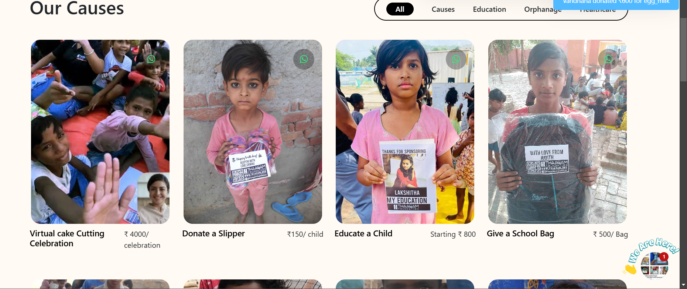
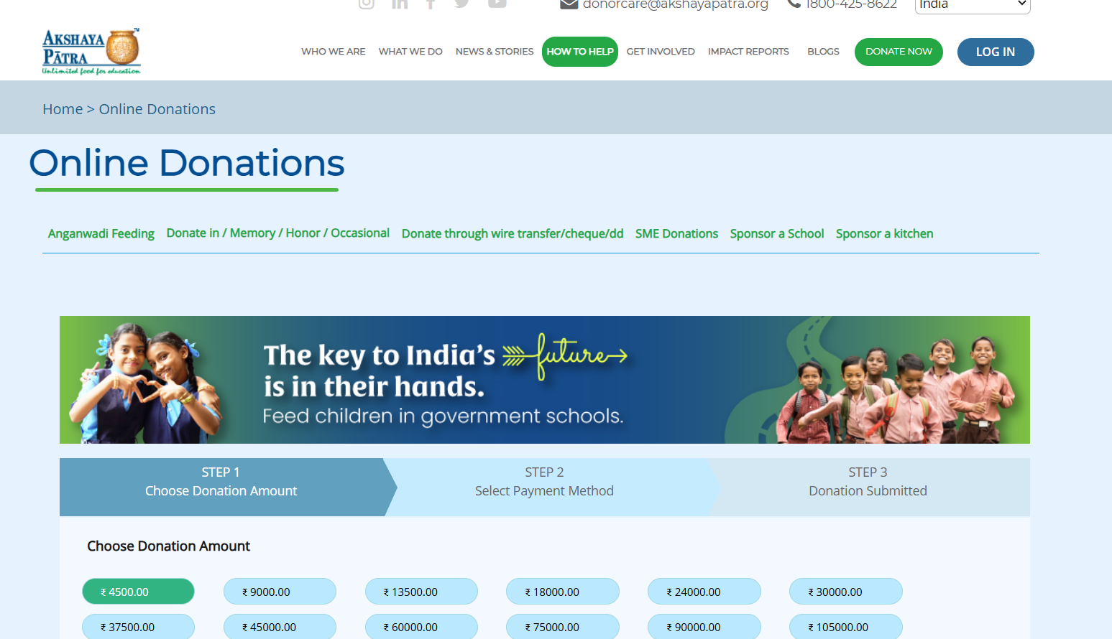
HOW IT IS DIFFERENT FROM EXISTING?
🏦 Other platforms (e.g., Thaagam, Akshaya Patra) primarily collect monetary donations to prepare and distribute food.
🧑‍🤝‍🧑 Meal Mitra enables direct user-to-user food donations, eliminating intermediaries.
⚡ Faster food distribution by allowing real-time listings and direct communication between donors and recipients.
🔍 More transparency as donors and recipients can directly connect, track food status, and verify details.
🌍 Reduces both hunger and food waste by utilizing surplus food that would otherwise be discarded.
📱 Community-driven platform, designed to be accessible for everyone, not just organizations or NGOs.

Slide 7
Software and Tools Used for Meal Mitra Website
Frontend
HTML: For the structure of the website.
CSS: For styling and layout.
JavaScript: For dynamic interactions and adding functionality to the website.
Database
MongoDB: A NoSQL database used to store user data, food donation details, and other information.
AI Chatbot
An AI-powered chatbot integrated to assist users with real-time queries and guide them through the donation process.
Communication
Twilio: For sending automated SMS messages to users, notifying them of updates related to their donations.
Code Editor
VS Code: For writing and editing code efficiently with various extensions for HTML, CSS, JavaScript, and MongoDB.

Slide 8
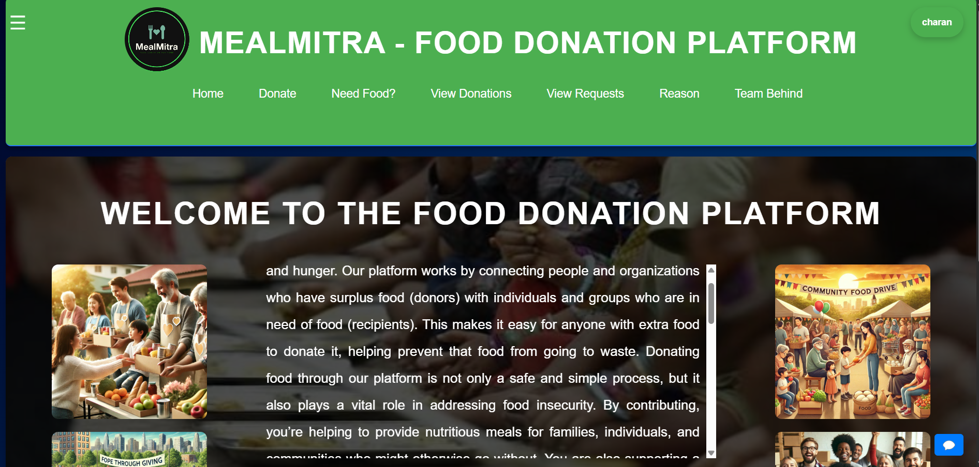
INTERFACE

Slide 9
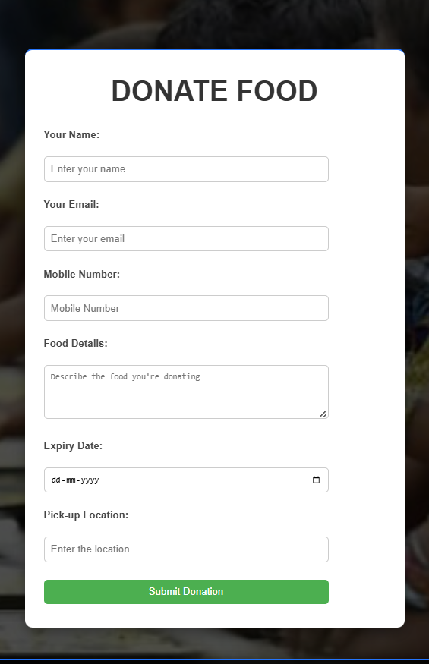
HOW TO DONATE ?
Visit Website: Open Meal Mitra website.
Go to Donate Section: Navigate to the “Donate Food” section.
Fill Details:
Name, Email, Mobile Number
Food Type, Quantity, Expiry Date
Pickup Location and Time
Submit Donation: Click “Submit Donation” to post.
View Donations: The donation appears in the “View Donations” section.

Slide 10
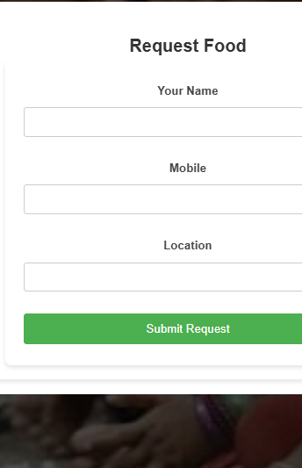
HOW TO REQUEST DONATION?
Go to “Need Food” Section: Navigate to the “Need Food” section on the website.
1
Fill Details:
2
Food Type, Quantity, Expiry Date
3
Name, Mobile Number, Location
4
Submit Request: Click “Submit Request” to post the food request.
5
View Request: Once submitted, the request will appear in the “View Requests” section.

Slide 11
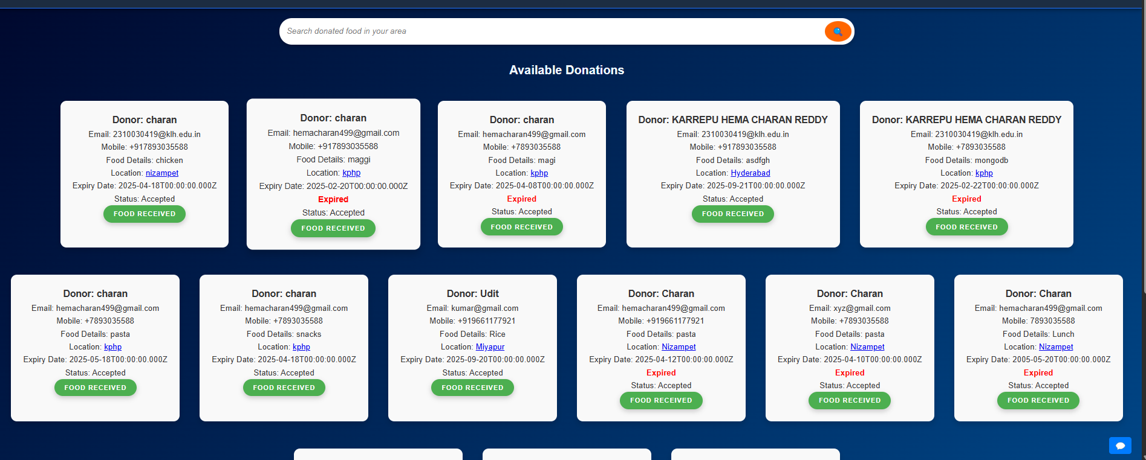
HOW TO VIEW DONATION?
Click on “View Donations”: Navigate to the “View Donations” section on the website.
1
Browse Donations: View all available donations listed with details such as food type, quantity, expiry date, and pickup location.
2
Accept Donation: After selecting a donation, click “Accept Donation”.
3
Get Notification: Once accepted, the user will receive a notification confirming the acceptance of the donation.
4
Fetch Location: Click on the location to view the pickup address on the map or fetch the directions.
5
Collect Food: Go to the pickup location at the designated time to collect the food.

Slide 12
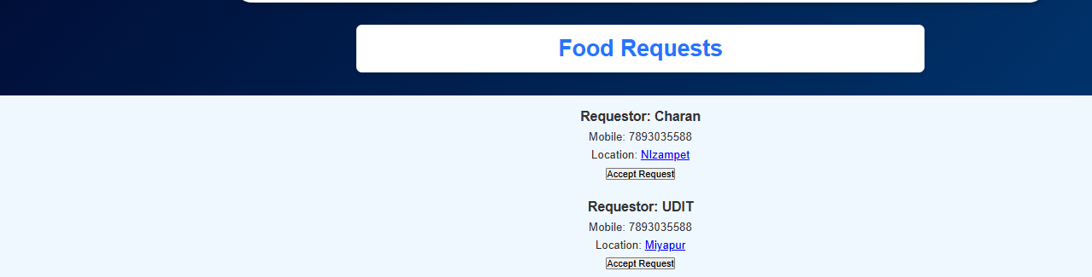
HOW TO SEE REQUESTED DONATIONS?
Click on “View Requests”: Navigate to the “View Requests” section on the website.
1
Browse Requests: View all posted food requests with details such as food type, quantity, expiry date, and location.
2
Accept Request: After selecting a request, click “Accept Request”.
3
Get Notification: Once accepted, the user will receive a notification confirming the acceptance of the request.
4
Fetch Location: Click on the location to view the pickup address or fetch directions.
5
Donate Food: Go to the pickup location at the designated time to donate the food.

Slide 13
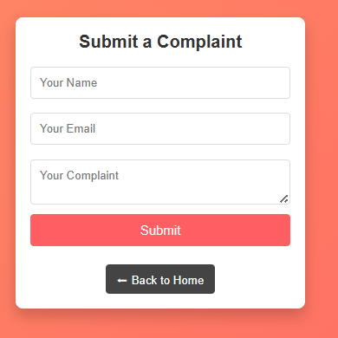
HOW TO REPORT?
Click on the Three Lines (Hamburger Menu):
At the top of the website, click on the three horizontal lines (hamburger menu) to open the navigation menu.
Select “Report”:
In the menu, find and click on the “Report” option to access the reporting form.
Fill in the Report Details:
Enter the relevant information such as the issue description, contact details, and any screenshots (if necessary).
Submit the Report:
After filling in the details, click on “Submit Report” to send your report to the platform’s support team.
Confirmation:
Once submitted, the user will receive a confirmation notification that their report has been received and is being processed.

Slide 14
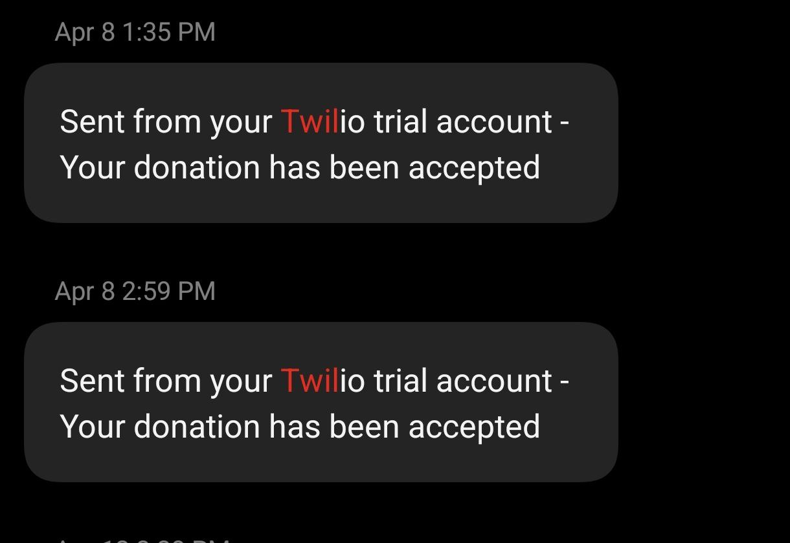
NOTIFICATION

Slide 15
CONCLUSION
Meal Mitra simplifies food donation and request management.
Provides an easy-to-use interface with real-time updates and notifications.
AI chatbot for support and Twilio for SMS notifications.
Location-based services for easy collection and donation.
Aims to reduce food waste and alleviate hunger in the community.
Built with MongoDB for efficient data storage.

Slide 16

THANK YOU!!

